Slide 1
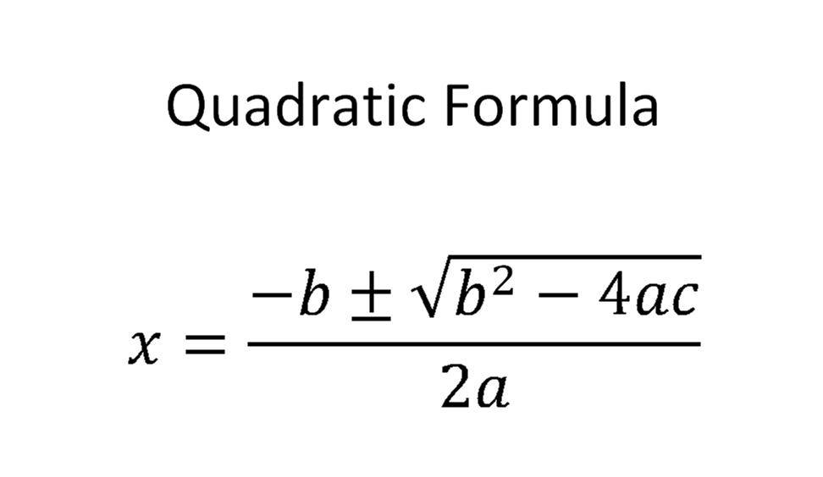
Summer School Algebra 2 A
Quadratics Portfolio
(make a copy to edit)
Unit 2
Video instructions

Slide 2
Solving quadratic equations
Write 2-3 sentences describing how you can use the form of a quadratic equation to decide how it can most efficiently be solved. What are you looking for when you decide which method to use?
type answer here

Slide 3
CHOOSE FROM LIST OF EQUATIONS OR CREATE YOUR OWN TO ANSWER QUESTIONS
y = -x²+4
y = 2x²+7x+3
y = (x-10)(x+1)
y = 2x²-8x-1
y = 2(x-5)²-2
y = (x+1)²-9
y = x²-25
x²+4x = 12
y= x²+3x-2
y = x²+3x+7

Slide 4
Solving by Factoring
Example of an equation (you can use your lesson or online examples or make it up yourself)
Solution
Explain why Factoring is the best method for that equation (explain like you would to a friend detail-wise). Why would other methods not be the best options?

Slide 5
Square Root
Example of an equation
Solution
Explain why this method is the best method for that equation (explain like you would to a friend detail-wise). Why would other methods not be the best options?

Slide 6
Completing the Square
Example of an equation
Solution
Explain why this method is the best method for that equation (explain like you would to a friend detail-wise). Why would other methods not be the best options?

Slide 7
Quadratic Formula
Example of an equation (consider one with imaginary solutions)
Solution
Explain why this method is the best method for that equation (explain like you would to a friend detail-wise). Why would other methods not be the best options?

